Slide 1
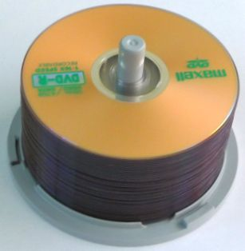

Introduction to Stacks
What is a Stack?
Stack implementation using array.
Stack implementation using linked list.
Applications of Stacks.

Slide 2
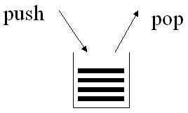
What is a Stack?
A stack is a data structure in which data is added and removed at only one end called the top.
To add (push) an item to the stack, it must be placed on the top of the stack.
To remove (pop) an item from the stack, it must be removed from the top of the stack too.
Thus, the last element that is pushed into the stack, is the first element to be popped out of the stack.
  i.e., A stack is a Last In First Out (LIFO) data structure

Slide 3
An Example of a Stack
2
8
1
7
2
8
1
7
2
top
1
7
2
top
top
Push(8)
Push(2)
pop()
8
1
7
2
1
7
2
7
2
top
top
top
pop()
pop()

Slide 4
Stack Implementations
In our implementations, a stack is a container that extends the AbstractContainer class and implements the Stack interface:
We shall study two stack implementations:
  StackAsArray
    The underlying data structure is an array of Object
  StackAsLinkedList
    The underlying data structure is an object of MyLinkedList
public interface Stack extends Container {
public abstract Object getTop();
public abstract void push(Object obj);
public abstract Object pop();
}

Slide 5
StackAsArray – Constructor
In the StackAsArray implementation that follows, the top of the stack is array[count – 1] and the bottom is array[0]:
The constructor’s single parameter, size, specifies the maximum number of items that can be stored in the stack.
The variable array is initialized to be an array of length size.
public class StackAsArray extends AbstractContainer
implements Stack {
protected Object[] array;
public StackAsArray(int size){
array = new Object[size];
}
// …

Slide 6
StackAsArray – purge() Method
The purpose of the purge method is to remove all the contents of a container.
To empty the stack, the purge method simply assigns the value null to the first count positions of the array.
public void purge(){
while(count > 0)
array[--count] = null;
}
Complexity is O(…)
Notes:
O(count) or O(n) if we assume that n is the original number of elements in the stack

Slide 7
StackAsArray – push() Method
push() method adds an element at the top the stack.
It takes as argument an Object to be pushed.
It first checks if there is room left in the stack. If no room is left, it throws a ContainerFullException exception. Otherwise, it puts the object into the array, and then increments count variable by one.
public void push(Object object){
if (count == array.length)
throw new ContainerFullException();
else
array[count++] = object;
}
Complexity is O(…)
Notes:
O(1)

Slide 8
StackAsArray – pop() Method
The pop method removes an item from the stack and returns that item.
The pop method first checks if the stack is empty. If the stack is empty, it throws a ContainerEmptyException. Otherwise, it simply decreases count by one and returns the item found at the top of the stack.
public Object pop(){
if(count == 0)
throw new ContainerEmptyException();
else {
Object result = array[--count];
array[count] = null;
return result;
}
}
Complexity is O(…)
Notes:
O(1)

Slide 9
StackAsArray – getTop() Method
getTop() method is a stack accessor which returns the top item in the stack without removing that item. If the stack is empty, it throws a ContainerEmptyException. Otherwise, it returns the top item found at index count-1.
  public Object getTop(){
  if(count == 0)
  throw new ContainerEmptyException();
  else
  return array[count – 1];
  }
Complexity is O(…)
Notes:
O(1)

Slide 10
StackAsArray – iterator() Method
public Iterator iterator() {
return new Iterator() {
private int index = count-1;
public boolean hasNext() {
return index >=0;
}
public Object next () {
if(index < 0)
throw new NoSuchElementException();
else
return array[index--];
}
};
}

Slide 11
StackAsLinkedList Implementation
In the singly-linked list implementation, the top of the stack is the first node in the list.
public class StackAsLinkedList
extends AbstractContainer
implements Stack {
protected MyLinkedList list;
public StackAsLinkedList(){
list = new MyLinkedList();
}
public void purge(){
list.purge();
count = 0;
}
// …
Complexity is O(…)
Notes:
O(count)

Slide 12
StackAsLinkedList Implementation (Cont’d)
public void push(Object obj){
list.prepend(obj);
count++;
}
public Object pop(){
if(count == 0)
throw new ContainerEmptyException();
else{
Object obj = list.getFirst();
list.extractFirst();
count--;
return obj;
}
}
public Object getTop(){
if(count == 0)
throw new ContainerEmptyException();
else
return list.getFirst();
}
Complexity is O(…)
Complexity is O(…)
Complexity is O(…)
Notes:
Push: O(1)
Pop: O(1)
getTop: O(1)

Slide 13
StackAsLinkedList Implementation (Cont’d)
public Iterator iterator() {
return new Iterator() {
private MyLinkedList.Element position =
list.getHead();
public boolean hasNext() {
return position != null;
}
public Object next() {
if(position == null)
throw new NoSuchElementException();
else {
Object obj = position.getData();
position = position.getNext();
return obj;
}
}
};
}

Slide 14
Applications of Stacks
Some direct applications:
  Conversion of tail-recursive algorithms to iterative ones. [Note: Tail recursion will be covered in a later lesson]
  Keeping track of method calls: Method activation records are saved on the run-time stack
  Evaluation of arithmetic expressions by compilers [infix to postfix conversion, infix to prefix conversion, evaluation of postfix expressions]
Some indirect applications
  Auxiliary data structure for some algorithms
    Example: Converting a decimal number to another base
  Component of other data structures
    Example: In this course we will use a stack to implement a Tree iterator

Slide 15
Application of Stacks - Evaluating Postfix Expressions
(5+9)*2+6*5
An ordinary arithmetical expression like the above is called infix-expression -- binary operators appear in between their operands.
The order of operations evaluation is determined by the precedence rules and parentheses.
When an evaluation order is desired that is different from that provided by the precedence, parentheses are used to override precedence rules.

Slide 16
Application of Stacks - Evaluating Postfix Expressions (Cont’d)
Expressions can also be represented using postfix notation - where an operator comes after its two operands or prefix notation – where an operator comes before its two operands.
The advantage of postfix and prefix notations is that the order of operation evaluation is unique without the need for precedence rules or parentheses.
Infix Notation | Postfix (Reverse Polish) Notation | Prefix (Polish) Notation
16 / 2 | 16 2 / | / 16 2
(2 + 14)* 5 | 2 14 + 5 * | * + 2 14 5
2 + 14 * 5 | 2 14 5 * + | + * 2 14 5
(6 – 2) * (5 + 4) | 6 2 - 5 4 + * | * - 6 2 + 5 4

Slide 17
Infix to Postfix conversion (manual)
An Infix to Postfix manual conversion algorithm is:
  1. Completely parenthesize the infix expression according to order of priority you want.
  2. Move each operator to its corresponding right parenthesis.
  Remove all parentheses.
Examples:
  3 + 4 * 5 (3 + (4 * 5) ) 3 4 5 * +
a / b ^ c – d * e – a * c ^ 3 ^ 4 a b c ^ / d e * a c 3 4 ^ ^ * - -
((a / (b ^ c)) – ((d * e) – (a * (c ^ (3 ^ 4) ) ) ) )

Slide 18
Infix to Prefix conversion (manual)
An Infix to Prefix manual conversion algorithm is:
  1. Completely parenthesize the infix expression according to order of priority you want.
  2. Move each operator to its corresponding left parenthesis.
  Remove all parentheses.
Examples:
3 + 4 * 5 (3 + (4 * 5) ) + 3 * 4 5
a / b ^ c – d * e – a * c ^ 3 ^ 4 - / a ^ b c - * d e * a ^ c ^ 3 4
( (a / (b ^ c)) – ( (d * e) – (a * (c ^ (3 ^ 4) ) ) ) )

Slide 19
Application of Stacks - Evaluating Postfix Expression (Cont’d)
The following algorithm uses a stack to evaluate a postfix expressions.
Start with an empty stack
for (each item in the expression) {
if (the item is an operand)
Push the operand onto the stack
else if (the item is an operator operatorX){
Pop operand1 from the stack
Pop operand2 from the stack
result = operand2 operatorX operand1
Push the result onto the stack
}
}
Pop the only operand from the stack: this is the result of the evaluation

Slide 20
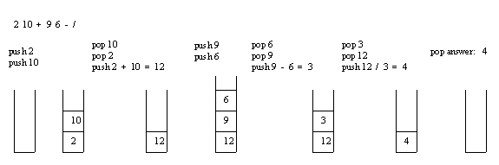
Application of Stacks - Evaluating Postfix Expression (Cont’d)
Example: Consider the postfix expression, 2 10 + 9 6 - /, which is (2 + 10) / (9 - 6) in infix, the result of which is 12 / 3 = 4.
The following is a trace of the postfix evaluation algorithm for the postfix expression:

Slide 21
Application of Stacks – Infix to Postfix Conversion
postfixString = “”;
while(infixString has tokens){
Get next token x;
if(x is operand)
Append x to postfixString;
else if(x is ‘(’ )
stack.push(x);
else if(x is ‘)’ ){
y = stack.pop();
while(y is not ‘(’ ){
Append y to postfixString;
y = stack.pop();
}
discard both ‘(‘ and ‘)’;
}
else if(x is operator){
while(stack is not empty){
y = stack.getTop(); // top value is not removed from stack
if(y is ‘(‘ ) break;
if(y has low precedence than x) break;
if(y is right associative with equal precedence to x) break;
y = stack.pop();
Append y to postfixString;
}
push x;
}

Slide 22
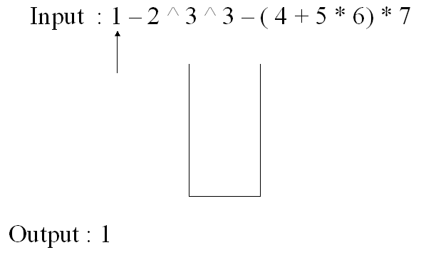
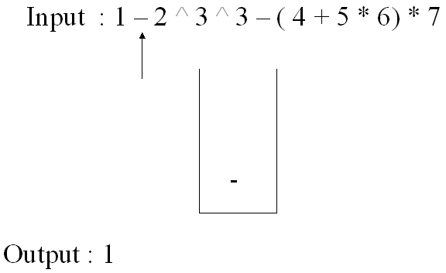
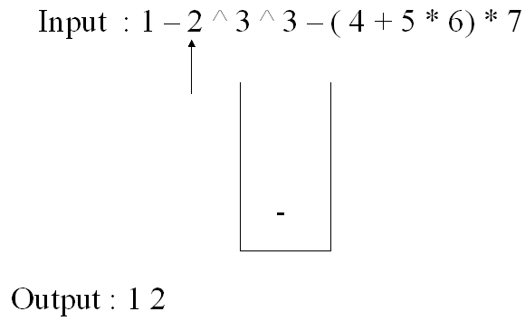
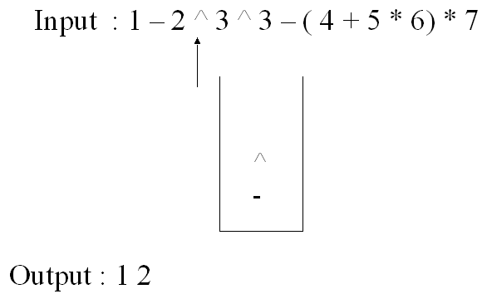
Application of Stacks – Infix to Postfix Conversion (cont’d)
while(stack is not empty){
y = stack.pop( );
Append y to postfixString;
}
step1:
step2:
step3:
step4:

Slide 23
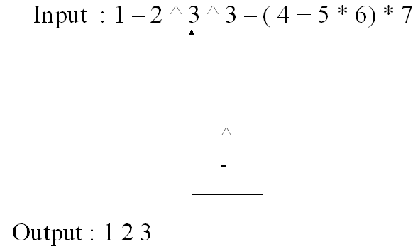
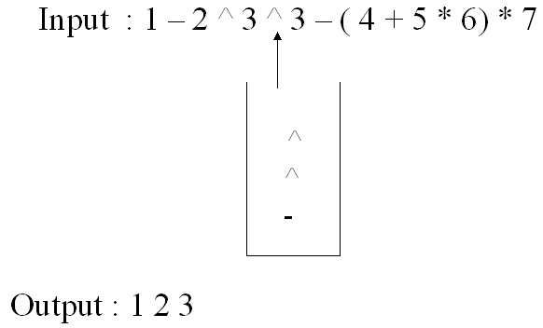
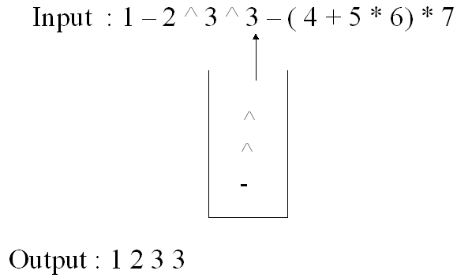
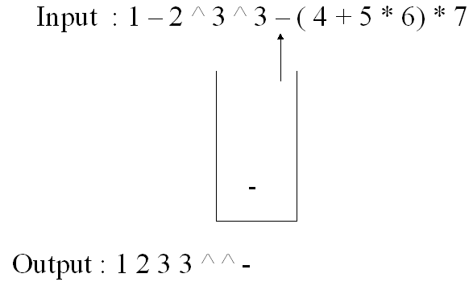
Application of Stacks – Infix to Postfix Conversion (cont’d)
step5:
step6:
step7:
step8:

Slide 24
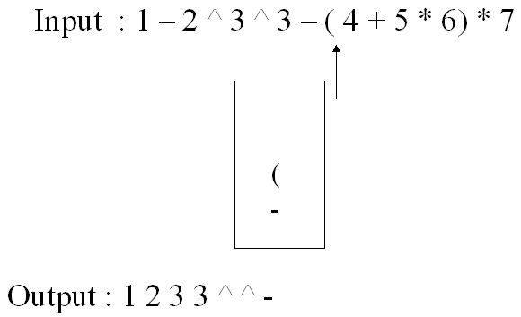
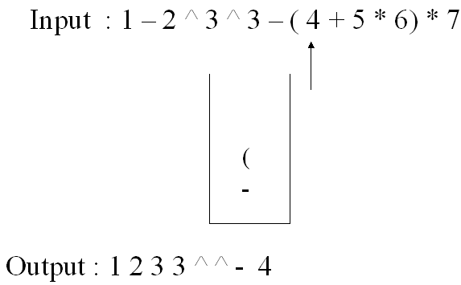
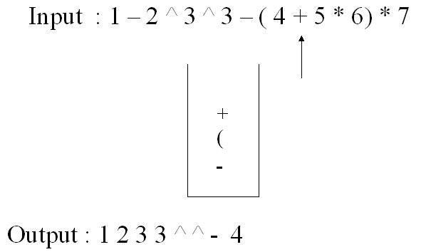
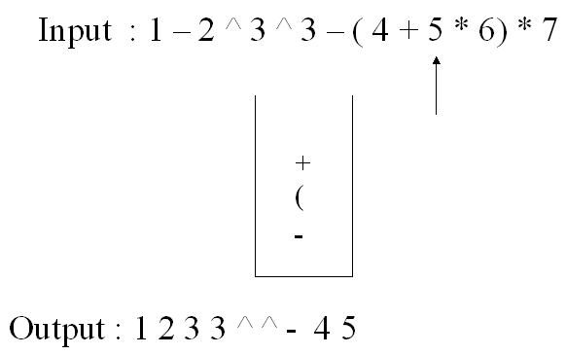
Application of Stacks – Infix to Postfix Conversion (cont’d)
step9:
step10:
step11:
step12:

Slide 25
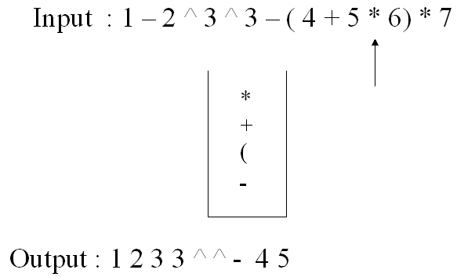
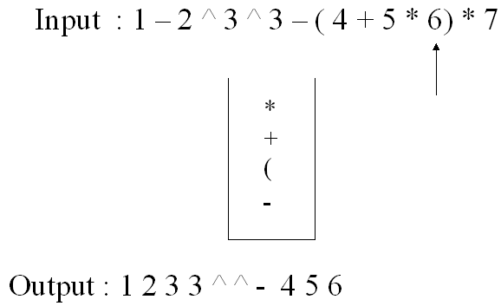
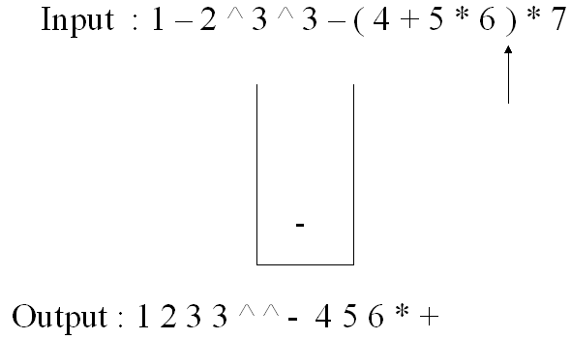
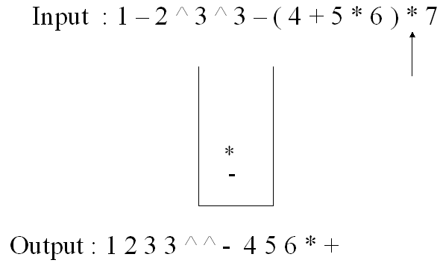
Application of Stacks – Infix to Postfix Conversion (cont’d)
step13:
step14:
step15:
step16:

Slide 26
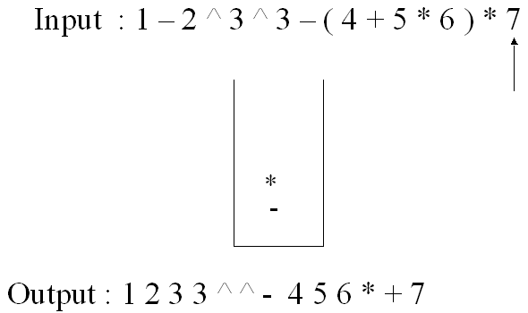
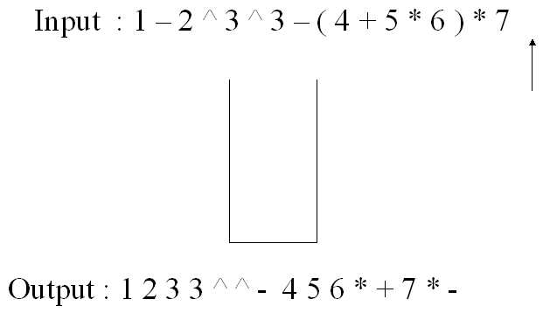
Application of Stacks – Infix to Postfix Conversion (cont’d)
step17:
step18:

Slide 27
Application of Stacks – Infix to Prefix Conversion
An infix to prefix conversion algorithm:
Reverse the infix string
Perform the infix to postfix algorithm on the reversed string
Reverse the output postfix string
Example: (A + B) * (B – C)
(C – B) * (B + A)
C B - B A + *
* + A B - B C
reverse
Infix to postfix algorithm
reverse

